Slide 1

Day 1 of 3 • The 2026 Etsy Upgrade Challenge
THE 2026 ETSY RESET
Delete the Dead Weight. Find Your Focus. Build a Shop That Actually Works.
with Bailey Vann • Top 0.1% Etsy Seller • $1M+ in Digital Product Sales • Mom of 4
Notes:
1

Slide 2
Before We Begin...
🎯 Quick Pop Quiz
I want to show you something that might change how you think about Etsy in 2026...
Notes:
2

Slide 3
💬
Get ready to type in the chat!
Notes:
3

Slide 4
Which design was made by a professional artist?
[Image A Placeholder]
[Image B Placeholder]
A
B
Notes:
4

Slide 5
🤔
Type A or B in the chat!
Notes:
5

Slide 6
The Answer Is...
Notes:
6

Slide 7
Both Were Made by AI.
In less than 30 seconds. For free.
Notes:
7

Slide 8
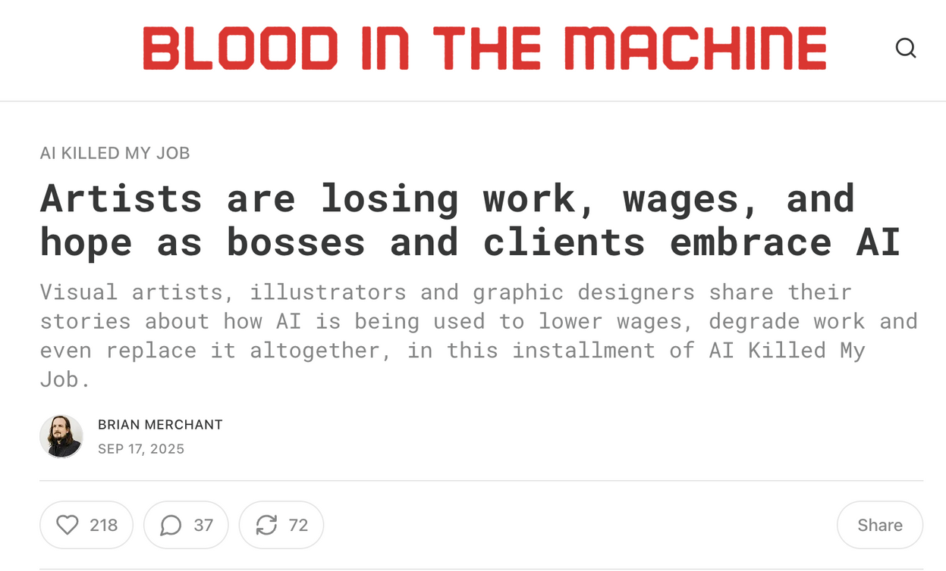
Yes, we all use AI nowadays...
But in 2026, they’ve gotten so good that hiring someone REAL is starting to become JUST an option at some areas in companies...
Notes:
8

Slide 9
Let that sink in for a second.
Notes:
9

Slide 10

Now let me ask you something uncomfortable...
Notes:
10

Slide 11
If anyone can create designs like this in seconds...
What happens to YOUR Etsy shop in 2026?
Notes:
11

Slide 12
The numbers I’m about to show you aren’t random...
These are from your OWN ANSWERS after I asked 160+ of you last week...
Notes:
9

Slide 13

📉
75+
of sellers report their shops tanked in the last 2 months...
If there are 4 people on your row in this chat, 3 of them are feeling this...
Notes:
14

Slide 14
❌
58+
sellers said their #1 problem: "No views anymore"
Not fewer views. Zero. Like a switch was flipped.”
Notes:
14

Slide 15
🤔
47+
said they have "No idea what to design"
They’re not lazy. They’re paralyzed because the rules changed and no one gave them the new playbook.
Notes:
14

Slide 16
💬
Does anyone else feel that way?
Type "YES" if you’re also seeing the same problems, I’m curious!
Notes:
17

Slide 17
So the real question isn't:
❌ "how do I make more listings?" ❌
Notes:
19

Slide 18
Is Etsy even worth pursuing in 2026?
Notes:
20

Slide 19
I'm going to answer that question tonight.
And the answer?
It might honestly surprise you.
Notes:
21

Slide 20
Because what nobody is talking about is this:
... The AI flood actually CREATES an opportunity - for a very specific type of seller...
🚨 BUT 🚨
... Only if you understand what's really happening...
Notes:
22

Slide 21
Here's the Truth About 2026:
Notes:
23

Slide 22
When everyone has access to AI...
The AI doesn't matter anymore.
Notes:
24

Slide 23
What Actually Matters?
FOCUS.
STRATEGY.
Knowing WHAT to create, not just HOW.
Notes:
25

Slide 24
If you’ve felt the same problems that those 160+ Etsy Shops have...
Notes:
19

Slide 25
Then you need a change of strategy...
Notes:
19

Slide 26
And my goal with tonight and the next 2 days is to hopefully help you build one that will allow you to make your Etsy Shop profitable...
Notes:
19

Slide 27
...so you can finally earn $3K-$5K monthly without needing to guess what will work based on "gut feeling"
Notes:
19

Slide 28


...and so you can enjoy more time with your family (or yourself) without spending time at 11PM searching for more “expert” Etsy advice
Notes:
19

Slide 29
The shops that will thrive in 2026 aren't the ones with the most listings...
They're the ones with the
CLEAREST FOCUS.
The shops that will thrive in 2026 aren't the ones with the most listings...
They're the ones with the
CLEAREST FOCUS.
Notes:
26

Slide 30
And that's exactly what we're building this week.
Notes:
27

Slide 31
The 3-Day Challenge
Your roadmap to a focused, profitable shop
Notes:
28

Slide 32
Day 1 — Tonight
The Etsy Reset
What to DELETE
What to OPTIMIZE
What to SCALE
Today is foundation. Without today, Days 2 & 3 don’t work.
Notes:
29

Slide 33
Day 2 — Tomorrow
The AI Design Lab
✓ Exact prompts that work in 2026
✓ Creating products people actually buy
✓ I will create a product LIVE with you
I’ll create a product live with you in under 30 minutes.
Notes:
29

Slide 34
Day 3 — Last Day
The AI Empire System
✓ The 3-hour weekly routine that compounds
✓ How to run your shop in less time than a movie
✓ The game plan for $3K-$5K monthly in 2026
The most important out of all 3 days...
Notes:
29

Slide 35
Plus, tomorrow?
Tomorrow, I’ll reveal something I've been building for months
. Something that doesn't exist anywhere else. Something I think will change the Etsy game in 2026.
If you show up tomorrow, you’ll get a chance to take a look at it before I show it to anyone else...
Notes:
29

Slide 36
⚠️
Important
Day 2 won't make sense without Day 1.
Day 3 won't work without Day 2.
This is a system. It only works if you follow it in order.
Notes:
32

Slide 37
🤝
If you’re serious… you need to be here all 3 nights. Deal?
Type "DEAL" in the chat so I know I can expect you to attend up to Day 3!
Notes:
33

Slide 38
Before We Dive In...
A Promise from me :)
Notes:
34

Slide 39
If you stay until minute 70 tonight...
I'm going to give you something very special.
Notes:
35

Slide 40
No, This is NOT:
❌ NOT in any workbook
❌ NOT in any course I've sold
...this is only for people who show up live today.
Notes:
36

Slide 41
you’ll be getting...
🎁 My Personal Delete Decision Matrix
Notes:
36

Slide 42
The exact checklist I use to decide what stays and what goes.
This is what I used when I deleted 80% of my shop and my revenue went up...
Notes:
37

Slide 43
With this tool, you can:
Benefit 1
Benefit 2
Benefit 3
...and much more!
Notes:
36

Slide 44
✅
But You’ll Get It Only If You Stay
You'll only get this if you're here at around minute 70.
(Trust me, you'll want it!)
Notes:
39

Slide 45
🗓️ The Agenda🗓️
🗓️ The Agenda🗓️
Here's What's REALLY Going to Happen Tonight...
Here's What's REALLY Going to Happen Tonight...
I believe in being upfront with you.
I believe in being upfront with you.
Notes:
40

Slide 46
Tonight's Plan
Minutes 0-60: Pure teaching.
Around Minute 70: I’ll give you the free bonus + I'll mention a VIP option for those who want extra support.
I thought I’d mention the plan because I don’t like sleazy surprises, and I assume you don’t either.
Notes:
41

Slide 47
So I want to be CLEAR:
Tonight is all about giving you everything you need to take action.
Whether or not you ever buy anything from me.
Notes:
43

Slide 48
👍
Is that cool with you?
Type "YES" in the chat
Notes:
42

Slide 49
One Small Ask Before We Begin...
Notes:
43

Slide 50
One Small Ask Before We Begin...
I want you to keep an open mind tonight. Some of what I'm about to share might feel counterintuitive. It might challenge what you've been told by other "Etsy experts."
That's okay.
Notes:
44

Slide 51
You don't have to agree with everything.
Just stay curious. Just stay open to "maybe."
Notes:
45

Slide 52
And I need a commitment from you.
If what I share tonight makes sense...
Will you actually TRY it?
Not just nod along.
Not just take notes.
Actually DO the thing?
Notes:
44

Slide 53
💭
Can you do that for the next 90 minutes?
Type MAYBE in the chat!
Notes:
42

Slide 54
But Before I Share Anything...
I want to know something from YOU.
Notes:
47

Slide 55
Why are you here?
Not ‘what do you want to learn’ - what’s actually at stake for you?
Notes:
48

Slide 56
Not "make money" — too vague.
Not "quit my job" — get more specific.
EXAMPLES:
→ "$2,000/month so I can cover daycare"
→ "Enough to pay off credit card by June"
→ "Prove to myself I can build something"
Notes:
50

Slide 57
💬
Type in the chat: "I'm here because..."
Notes:
49

Slide 58
I See You. I Hear You.
I try to read every single email reply from people who signed up:
Notes:
51

Slide 59
You’re not alone. Most people:
... it’s because they want to quit their job
... it’s because they want to pay off debt
... it’s because they want to be home with their kids
... it’s because they want to prove to themselves that they can actually do this
And for most, it’s actually just because they finally want a profitable side hustle after failing over & over again...
Notes:
50

Slide 60
If any of that sounds like you...
You're in the right place. And I know exactly how you feel.
Because I've been there.
Notes:
52

Slide 61

Let Me Tell You a Story...
✍️ The Prison I Built With My Own Hands ✍️
Notes:
53

Slide 62
A few years ago, I was doing the math...
And it wasn't adding up.
Notes:
54

Slide 63
My 9-5 paycheck
Daycare for 2 kids
What I actually kept
$3,200/month
−
$2,400/month
=
$800/month
Notes:
55

Slide 64
I was working 40+ hours a week...
And I was missing time with my kids:
Missing bedtime... missing fun time... and missing the most precious moments as a mother just for $800/mo...
Notes:
56

Slide 65
Naturally, something had to change.
Notes:
56

Slide 66
So I fell down the "make money online" rabbit hole...
Sound familiar?
Notes:
57

Slide 67
Here's what I tried:
❌ Dropshipping
❌ Kindle eBooks
❌ Affiliate Marketing
❌ MLMs
❌ Random "Passive Income" Schemes
Time went out. Money went out. Not much came back.
Notes:
58

Slide 68
🙋
I want to hear from you...
Type "SAME" if you've been there too
Notes:
60

Slide 69
Eventually, I Found Etsy.
And It Finally Worked.
Notes:
61

Slide 70
First: Handmade Glitter Resin Tumblers
They were trendy.
They sold.
Real money started coming in.
FOR BAILEY - INPUT ACTUAL DATA HERE
Notes:
62

Slide 71
Then: Sublimation Tumblers
50+ orders a day
Income was growing
I thought I'd made it.
FOR BAILEY - INPUT ACTUAL DATA HERE
Notes:
63

Slide 72
But there was a problem...
I escaped one prison and built another one.
Notes:
64

Slide 73
The Reality of my “Success”
→ 2 AM in the garage
→ Pregnant
→ Inhaling toxic epoxy fumes
→ Hands raw from chemicals
→ Orders piling up
→ Couldn't take a day off
Notes:
65

Slide 74
So I Made a Scary Decision:
So I Made a Scary Decision:
Notes:
66

Slide 75
I deleted ALL my physical products.
Every tumbler. Every order. Gone.
Notes:
67

Slide 76
People thought I was crazy.
I was making money! Why would I throw that away?
Notes:
68

Slide 77
I Rebuilt My Entire Shop Around One Thing:
Simple $3-$5 digital designs
No shipping.
No inventory.
No toxic fumes.
Just files people could download instantly.
Notes:
69

Slide 78
After that?
Notes:
70

Slide 79
$1,000,000+
in Etsy revenue... from those same $3-$5 digital designs:
Notes:
71

Slide 80
I now run a 0.1% Etsy Shop while still having time for my kid’s school pickups and soccer practice. Not 14-hour hustle days.
Notes:
72

Slide 81
But I’m Not Special...
No art degree.
No tech background.
No business connections.
No unfair advantages.
Just a mom who found a system and followed it consistently.
If I can do this, you absolutely can too.
Notes:
72

Slide 82
So What Actually Changed?
Notes:
73

Slide 83
✅ It Wasn't...
That I got "better at design."
That I worked harder.
That I found some secret hack.
Notes:
74

Slide 84
I Stopped and Started...
I stopped adding → Started deleting.
I stopped guessing. → Started deciding.
Most importantly...
I stopped trying to do EVERYTHING → Started doing ONE thing well.
Notes:
75

Slide 85
Now I want to ask you a question...
Now I want to ask you a question...
Notes:
77

Slide 86
📊
How many products do you currently have in your Etsy shop?
Type your number in the chat.
Notes:
78

Slide 87
Now here's the uncomfortable follow-up...
Notes:
79

Slide 88
How many of those products actually made good money last month?
Not "got a view."
Not "got favorited."
Actual sales.
Notes:
80

Slide 89
💬
Type that number in the chat again.
(Type zero if none.)
Notes:
81

Slide 90
Let's Do Some Quick Math:
Notes:
82

Slide 91
If you have:
100 listings
But here's what nobody tells you:
And only 10 sold last month:
Those 90 dead listings aren't just wasting money...
They're actively HURTING the 10 listings that ARE working.
90% is dead weight
Renewal fees wasted:
$27/year
Notes:
83

Slide 92
Why?
Etsy's algorithm doesn't know what your shop is about.
You're confusing it.
You're confusing customers.
You're confusing yourself.
Notes:
84

Slide 93
The Biggest Lie in Etsy:
Notes:
85

Slide 94
"More Listings = More Money"
Notes:
86

Slide 95
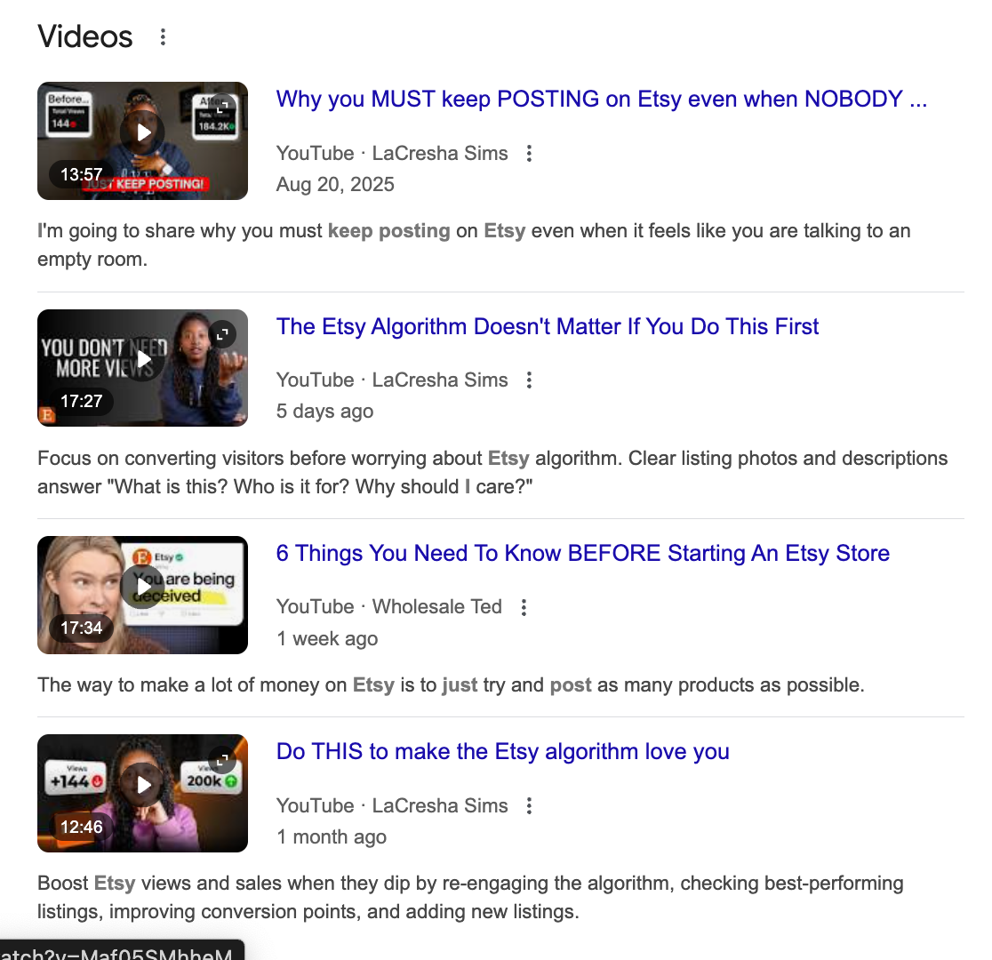
You've heard this everywhere:
"Just keep posting!"
"More listings = more chances!"
"The algorithm rewards activity!"
Notes:
87

Slide 96
This advice made sense in 2019.
In 2026? It's a recipe for invisibility.
The game changed; your strategy didn’t.
Notes:
88

Slide 97
It's Not Your Fault You Believed This...
Notes:
94

Slide 98
The advice that worked in 2019 doesn't work in 2026.
You're not behind. You're not broken.
You were just given the wrong map.
Notes:
96

Slide 99
The Old Way vs. The New Way
Notes:
97

Slide 100
❌ The Old Way
❌ The Old Way
"Just keep listing"
Chase every trend
More products = more chances
Copy what's selling
Hope the algorithm notices you
Result: Overwhelmed, scattered, invisible
Notes:
98

Slide 101
❌ The 2026 Way
✅ The 2026 Way
❌ The 2026 Way
✅ The 2026 Way
Delete what's not working
Pick ONE focus area
Focused products = clear identity
Create what YOU do best
Make the algorithm's job easy
Result: Focused, strategic, visible
Notes:
98

Slide 102
🌱
Think of Your Shop Like a Garden...
You can't plant new seeds if you're still watering dead plants.
🌱
Think of Your Shop Like a Garden...
You can't plant new seeds if you're still watering dead plants.
Notes:
99

Slide 103
Every Listing is a Plant...
🪴 Dead plants = Listings with 0 sales in 90+ days
🌱 Struggling plants = Getting views but not sales
🌻 Thriving plants = Your consistent sellers
Notes:
101

Slide 104
Tonight we're going to figure out which is which.
And I’m giving you permission to pull the weeds.
Notes:
102

Slide 105
Here’s the Framework To Use...
Here’s the Framework To Use...
✅ The 3-Column Framework ✅
✅ The 3-Column Framework ✅
Notes:
103

Slide 106
BAILEY NEEDS TO FILL IN INFO on the next few slides
Notes:
106

Slide 107
Every listing belongs in one of these three columns:
DELETE
OPTIMIZE
SCALE
Remove the dead weight
Fix what's almost working
Double down on winners
Notes:
104

Slide 108
we can have 50-60 pages of info/teaching here.
Notes:
106

Slide 109
Column 1: DELETE
Notes:
105

Slide 110
A listing goes in DELETE if:
✓ Zero sales in past 90 days despite getting views
✓ Doesn't fit your shop's core focus anymore
✓ Embarrassing — you wouldn't show it to someone today
✓ Low margin — not worth the $0.30 renewal
Notes:
106

Slide 111
The Sunk Cost Truth:
The time you spent creating it is already gone.
Keeping it doesn't get that time back —
it just
wastes more.
Notes:
107

Slide 112
Here's what helped me:
That listing isn't your baby.
It's an experiment that gave you data.
The data it gave you? "This doesn't work."
That's valuable.
Notes:
108

Slide 113
Every listing you delete makes room for something better.
Your future best-seller might not exist yet
because you're too busy managing duds.
Notes:
109

Slide 114
✓
Type "PERMISSION" if you need permission to delete.
I'm giving you permission.
Delete the dead weight.
Notes:
110

Slide 115
for the 3 column framework, THIS SLIDE IS ESSENTIAL
"On Day 3, I'll show you how to use this framework every single week automatically"
Notes:
116

